Slide 1
Lecture 15 Introduction to OpenACC
Kyu Ho Park
May 25, 2017
Ref:
1.David Kirk and Wen-mei Hwu, Programming Massively Parallel Processors, MK and NVIDIA.
2. Jeff Larkin, Introduction to OpenACC, NVIDIA.

Slide 2
3 Ways to Accelerate Applications
Applications
Libraries
OpenACC Directives
Programming Languages
“Drop-in” Acceleration
Easily Accelerate
Applications
directive – given by compiler, give some information to the compiler which part will be parallelized
Maximum Flexibility
Notes:
Many professional applications have already been ported to GPUs. If you are a developer interested in accelerating
your own application, you have 3 main options for adding GPU acceleration: In order of increasing effort, they are,
1. Drop in pre-optimized GPU-accelerated libraries as an alternative to MKL, IPP, FFTW and other widely used libraries
2. Use OpenACC directives (or compiler “hints”) in your source code to automatically parallelize compute-intensive loops
3. Use the programming languages you already know to implement your own parallel algorithms
For each performance-critical area in your application, these approaches can be used independently
or together.
For example, you might use a GPU-accelerated library to perform some initial calculations on your data and then use OpenACC to accelerate your own code to perform custom computations that are not (yet) available in a library.
CUDA is a parallel computing platform that supports all of these approaches. Here we present libraries and what it takes to get drop-in acceleration.

Slide 3

cuBLAS – basic linear algebra
NPP – image processing

Slide 4
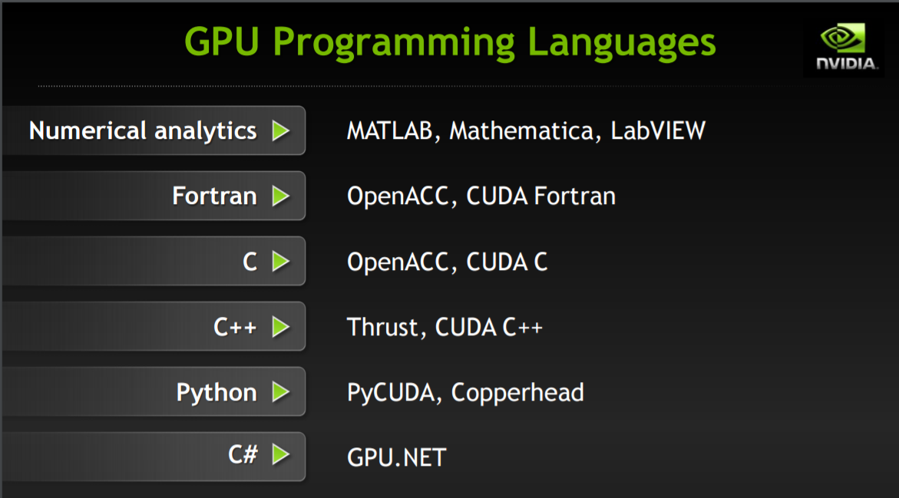

Slide 5
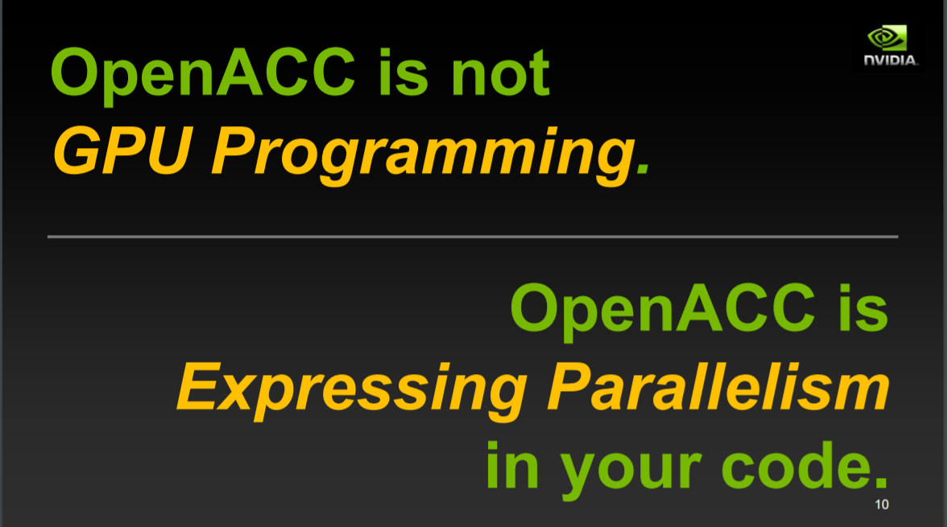

Slide 6
OpenACC
Program in C
#pragma acc parallel num_gangs(1024)
{
for( int i=0; i<2048;i++){ }
}
#pragma acc parallel loop copyin(A[0:M*N]) copyin(B[0:N*M]
copyout(C[0:M*N])
for(int i=0;i<M;i++){
---
}
gang – block
worker – warp
vector - thread

Slide 7
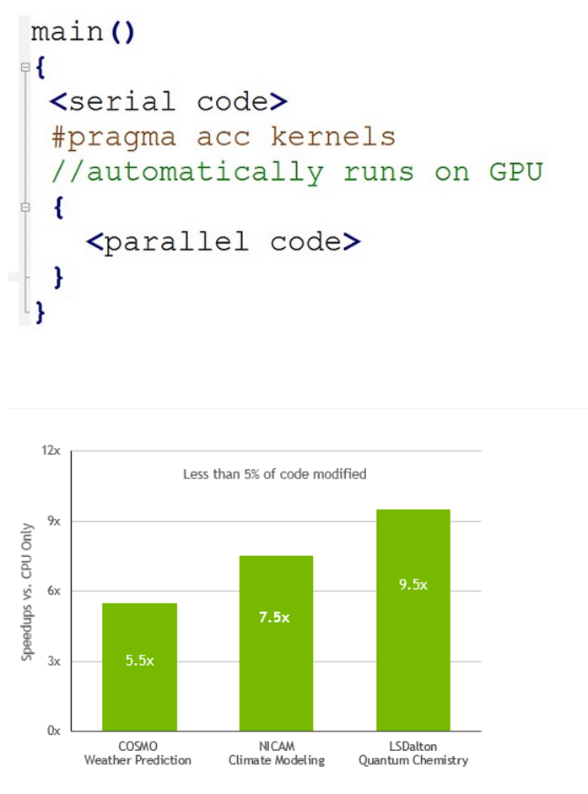
just modify the running program code

Slide 8
OpenACC
: Open Programming standard for Parallel Computing using GPU Directives.
High level programming model for accelerator based architectures.
Developed by a consortium consisting of
CAPS, CRAY, NVIDIA and the Portland Group.
The Reason to use OpenACC:
Productivity
Portability – openacc : independent of hardware architecture!
Performance feedback

Slide 9
Ex: Program in C
#pragma acc parallel num_gangs(1024)
{
for( int i=0; i<2048;i++){ }
}
Ex: Program in Fortran
!$acc parallel [clause …]
….
!$acc end parallel

Slide 10
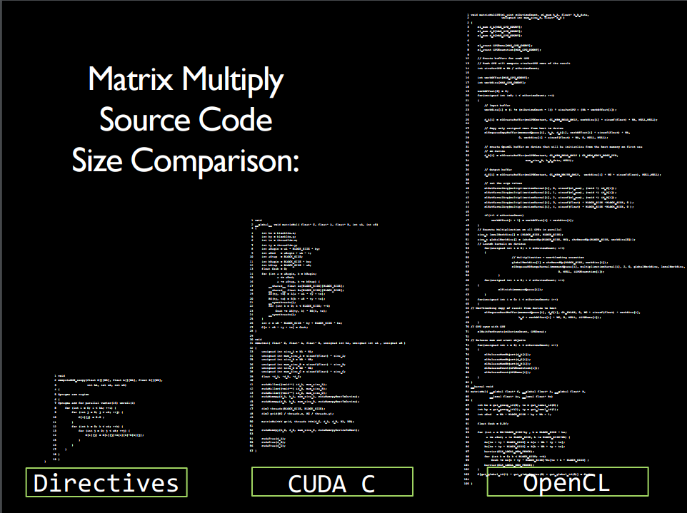
[Mathew Colgrove, Directive-based Accelerator Programming With OpenACC]

Slide 11
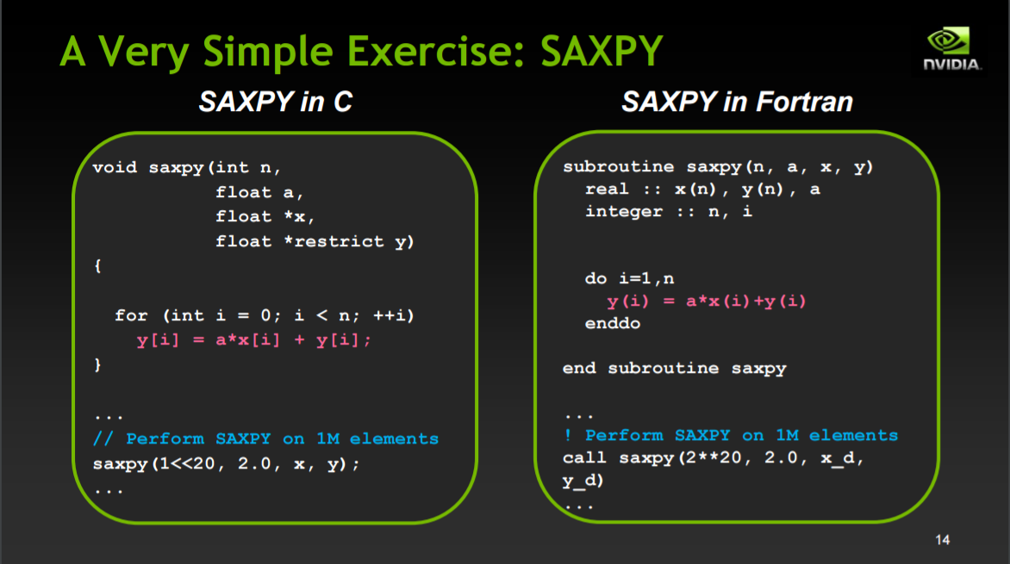

Slide 12
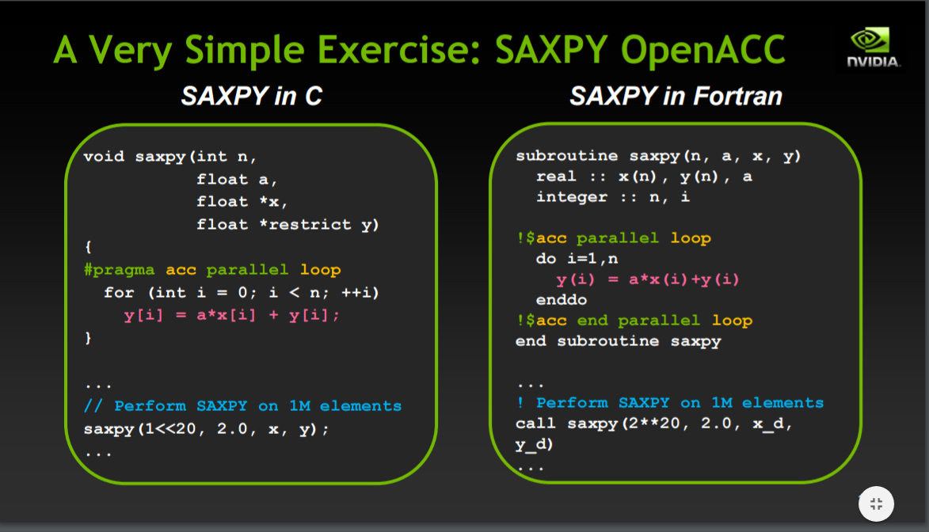

Slide 13
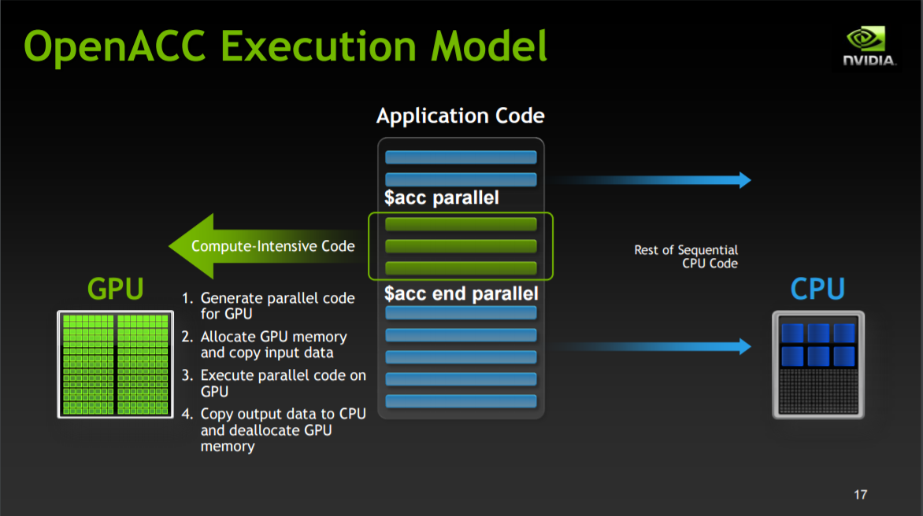

Slide 14
OpenACC
The standard for GPU Directives
Simple: The easy way to accelerate compute intensive applications.
Open: Making GPU programming straightforward and portable across parallel and multi-core processors.
Powerful: It allows complete access to the massive parallel power to a GPU.
High-Level: Compiler directives to specify parallel regions in C & Fortran → Portable across OSes, host CPUs, Accelerators and Compilers.

Slide 15
Benefit of OpenACC[1]
OpenACC programmers can start with writing a sequential version and then annotate their sequential program with OpenACC directives.
OpenACC provides an incremental path for moving legacy applications to accelerators. Adding directives disturbs the existing code less than other approaches.
OpenACC allows a programmer to write OpenACC programs in such a way that when the directives are ignored , the program still sequentially and gives the same result as when the program is run in parallel( this property does not hold automatically for all OpenACC programs).

Slide 16
Properties of OpenACC
Some OpenACC directives are hints to the OpenACC compilers.
It is possible to write OpenACC programs that gives the same execution result as when the directives are ignored, this property does not hold automatically for all Open ACC programs.

Slide 17
Execution Model
OpenACC: Host + Accelerator device
Host:
Main program on CPU
Code is transferred to the Accelerator
Execution is started
Wait for completion
Accelerator Device
Gangs
Workers
Vector Operations

Slide 18
OpenACC Task Granularity
vector
Worker
Gang
Worker
Worker
Gang
The accelerator is a collection of Processing Elements(PEs) where each PE is multithreaded and each thread can execute vector instructions.

Slide 19
Relations between CUDA and OpenACC Tasks
OpenACC CUDA
Gang Block
Worker Warp
Vector Thread

Slide 20
Memory Model
The host memory and the device memory are separate spaces in OpenACC.
The host can not access the device memory directly and the device can not access host memory directly.
In CUDA C, programmers should explicitly code data movement through APIs.
In OpenACC, we just annotate which memory objects need to be transferred.
Ex.:
#pragma acc parallel loop copyin(M[0:Mh*Mw]) copyin(N[0:Nw*Mw]) copyout(P[0:Mh*Mw])

Slide 21
OpenACC programs
Accelerator Compute Constructs
parallel
kernel
loop
data

Slide 22
Parallel Construct
To specify which part of the program is to be executed on the accelerator, there are two construct:
parallel construct
kernel construct
When a program encounters a parallel construct, the execution of the code within the structured block of the construct( called a parallel region) is moved to the accelerator. Gangs of workers on the accelerator are created to execute the parallel region.
Initially only one worker(called a gang lead) within each gang will execute the parallel region. The other workers are conceptually idle at this point. They will be deployed when there is more parallel work at an inner level.
Ex:
#pragma acc parallel copyout(a) num_gangs(1024) num_workers(32)
{ a=32; }

Slide 23
Loop Construct-Gang Loop
Parallel Construct
Gang Loop
#pragma acc parallel num_gangs(1024)
{
for( int i=0; i<2048; i++){
c[i]=a[i] + b[i];
}
}
#pragma acc parallel num_gangs(1024)
{
#pragma acc loop gang
for(int i=0;i<2048; i++){
c[i]=a[i]+b[i];
}
}

Slide 24
Gang Loop
At the first program [#pragma acc parallel num_gangs(1024)]
All 2,048 iterations will be executed sequentially and redundantly by the 1,024 gang leads.
To get speedup, you need to distribute the 2,048 iterations among the gangs. Each gang lead will be assigned 2 iterations.

Slide 25
Loop Construct-Worker Loop
Worker loop
Ex:
#pragma acc parallel num_gangs(1024) num_workers(32)
{
#pragma acc loop gang
for (int i=0; i<2048;i++){
#pragma acc loop worker
for (int j=0; j<512; j++){
foo(i,j);
}
}
}

Slide 26
Worker Loop Construct
The compiler and runtime will make sure that the iterations of a worker loop are shared among all workers within a gang through ‘worker loop construct’.
foo: 2048x 512 instances will be executed.
In the program, 1024x32 workers will be active ,
(2048x512)/(1024x32)=32 instances / worker.

Slide 27
Loop Construct-Vector Loop
#pragma acc parallel num_gangs(1024) num_workers(32) vector_length(32)
{
#pragma acc loop gang
for(int i=0;i<2048; i++0){
#pragma acc loop worker
for (int j=0; j<512; j++){
#pragma acc loop vector
for( int k=0; k<1024; k++){
foo(i,j,k);
}
}
}
}

Slide 28
Kernel Construct
A kernel region may be broken into a sequence of kernels, each of which will be executed on the accelerator, while the whole parallel region will become a kernel.
Ex:
#pragma acc kernels
{
#pragma acc loop num_gangs(1024)
for(int i=0; i<2048; i++){
a[i]=b[i]; }
#pragma acc loop num_gangs(512)
for (int j=0; j<2048;j++){
c[j]=a[j]*2;}
for(int k=0; k<2048;k++){
d[k]=c[k];}
}

Slide 29
Data Management
Data Clauses:
copyin(list) : copies from host to device
copyout(list) : copies from device to host
copy(list); : copies from host to device and back to host//#pragma acc kernels copy(x[0:1024],a)
create(list); //to generate and consume within a kernel
deviceptr(list)
and others…
Data Construct
#pragma acc data copy(field) create(tmpfield)

Slide 30
Asynchronous Computation and Data Transfer
‘async’ clause can be added to parallel, kernel, or update directive to enable asynchronous execution.
If there is no async clause, the host process will wait until the parallel region, kernel region, or updates are complete before continuing.
Ex:
#pragma acc parallel async

